Slide 1
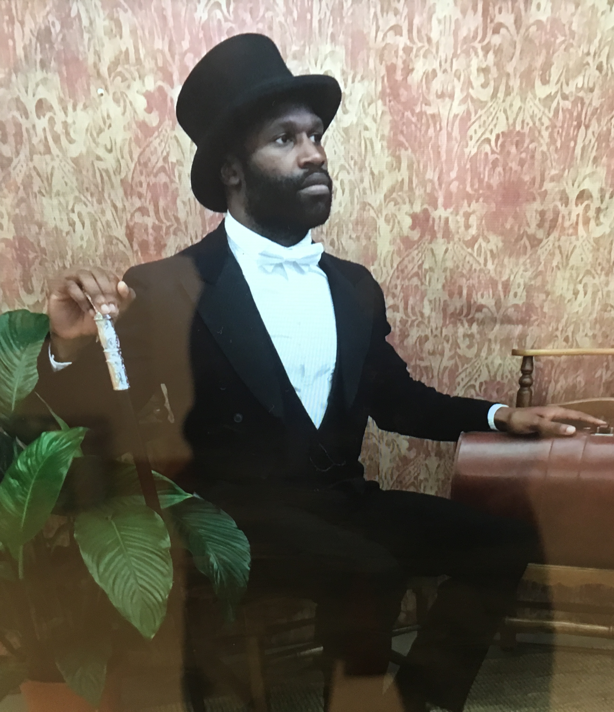
PAUL ANDREW
www.paulandrew.co.uk
www.dramageezers.com
Paul Andrew is a Storyteller/Creative facilitator who trained at East 15 Drama School and graduated with a BA Hons in Community Theatre. He has various experience working with people of all ages, abilities, and backgrounds, as well as ESOL speakers. Through training within the specialist area of acting and facilitation, alongside undertaking professional placements, employment experience and working with numerous different companies. He has been able to run many successful workshops for adults and young people. Over the years he has used a variety of skills from drama, music, and storytelling to encourage, build confidence and create a sense of self belonging in people.

Slide 2
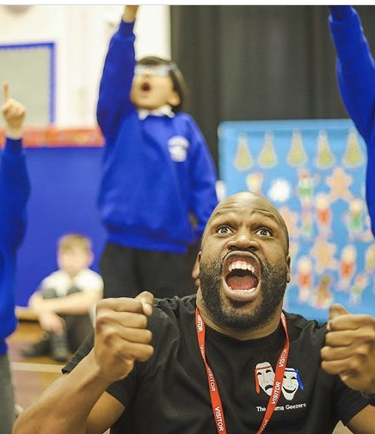
Enjoy What Ever you do.
My Top Tips!

Slide 3
Never Give up.

Slide 4
Don’t be Afraid to ask for help or Advice.

Slide 5
